Slide 1

Multiple Comparisons and Fisher’s LSD
Reading: 5.7
exercises: Ch 5. 45, 47, 62, 64
Assigned: hw 10
Producer: dr. mario
img credit: alex riegert-waters

Slide 2

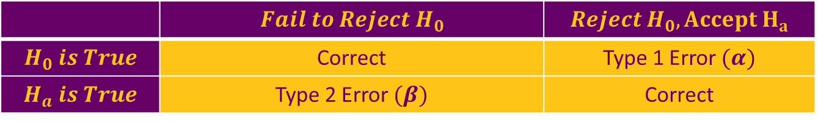
Motivation
Types of Errors
When Doing Hypothesis Tests or Confidence Intervals, We Typically Control $α$ Which is the Probability of a Type 1 Error (i.e. $α=0.05$)
Typically, Researchers are Hoping to Achieve Significance
 | $$Fail to Reject H_{0}$$ | $$Reject H_{0}, Accept H_{a}$$
$$H_{0} is True$$ | Correct | Type 1 Error $(α)$
$$H_{a} is True$$ | Type 2 Error $(β)$ | Correct

Slide 3
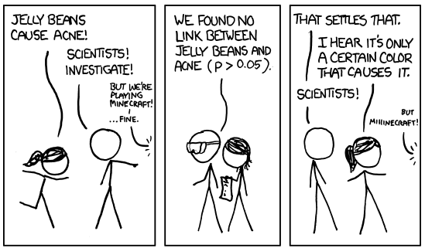
Motivation

Slide 4
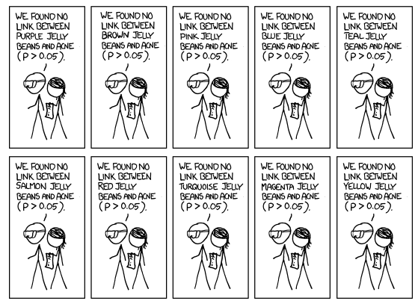
Motivation

Slide 5
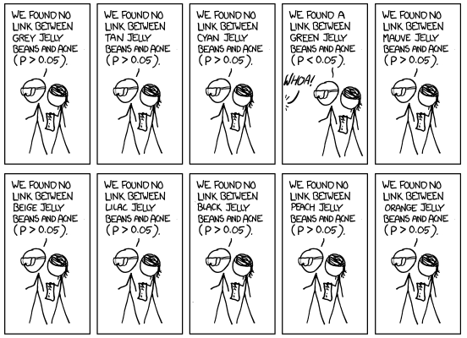
Motivation

Slide 6
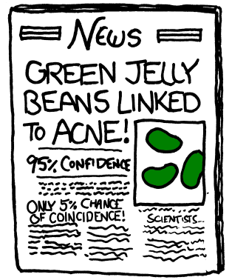
Motivation
“If you torture your data long enough, they will confess.”
- I. J. Good (Jack Good)
img credit: https://xkcd.com/882/

Slide 7

Motivation
ANOVA Model $Y=μ+α_{i}+ε$ where $i∈\{1,2,..,50\}$
Null Hypothesis is a Strict Statement (i.e. $H_{0}:α_{8}=0$)
Alternative Hypothesis is the Opposite (i.e. $H_{a}:α_{8}≠0$)
Truth: Null Hypothesis is Highly Unlikely to Actually Be True Therefore Just Keep Increasing Your Sample Size
This is NOT the Focus of the Textbook

Slide 8

Motivation
ANOVA Model $Y=μ+α_{i}+ε$ where $i∈\{1,2,..,50\}$
Suppose $H_{0i}:α_{i}=0$ is True for all $i∈\{1,2,..,50\}$
$P\left(Type 1 Error for i\right)=0.05$
$P\left(At Least One Type 1 Error\right)=1−{\left(0.95\right)}^{50}=0.923$
Individual False Alarm Rate is the Chance of a Type 1 Error for a Single Test (i.e. 0.05)
Familywise False Alarm Rate is the Chance of at least one Type 1 Error Among a Family of Multiple Tests

Slide 9
Motivation
Conclusion: The probability of making a Type 1 Error increases as we increase the number of hypothesis tests we do or the number of confidence intervals we create.
Ethical Options to Manage this Problem
Do Only a Few Hypothesis Tests or Confidence Intervals that were Selected Prior to Acquiring Data/Performing Analysis
Adjust the Significance Level for Each Test So the Familywise False Alarm Rate is Small

Slide 10


Estimating Differences in Group Means
Assume ANOVA F-Test Resulted in Rejecting Null Hypothesis
Confidence Interval For Differences Between Group Means
We Want to Use the Confidence Interval to Test Hypotheses
$H_{0}:μ_{i}=μ_{j}$ (Assume to Be True)
$H_{a}:μ_{i}≠μ_{j}$ (Accept if 0 is not in Interval)
$$μ_{i}≠μ_{j} for some i≠j$$
$${(\overline{y}}_{i}−{\overline{y}}_{j})±t_{0.975,n−K} \sqrt{\frac{MSE}{n_{i}}+\frac{MSE}{n_{j}}}$$

Slide 11
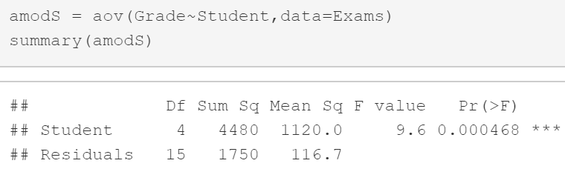
Example: Grades on Different Exams
ANOVA Model and Output
We Have Evidence that At Least One Student Has an Average Grade that is Different Than the Average Grade of Another Student

Slide 12

Example: Grades on Different Exams
Question: How many differences could we estimate?
Formula: $"\text{5 }\text{Choose}\text{ 2"}=\left({5 \atop 2}\right)=\frac{5!}{2!\left(5−2\right)!}=\frac{5×4×3!}{2!3!}=\frac{20}{2}=10$
Require 10 Confidence Intervals to Test All Pairwise Comparisons
Barb vs. Betsy Barb vs. Bill Barb vs. Bob
Barb vs. Bud Betsy vs. Bill Betsy vs. Bob
Betsy vs. Bud Bill vs. Bob Bill vs. Bud
Bob vs. Bud

Slide 13
Thank You
Make Reasonable Decisions

